Slide 1

PUSL2019 Information Management and Retrieval
Coursework
2023-2024

Slide 2

PUSL2019 Information Management and Retrieval
presentation
2023-2024

Slide 3

Database for NSBM Green University

Slide 4
Outline of the Presentation:
Introduction
Project Overview
Database Design
Data Modeling
Implementation
Testing
Results and Analysis
Challenges Faced
Future Enhancements
Conclusion

Slide 5

Introduction
The students are Expected to create a database for NSBM Green University by considering all the operations related to the students. Mainly Registrations, Examinations, and their Access related details. The students are expected to study the university management system to propose a new database solution to upgrade the available solution.

Slide 6


FOR STUDENT LECTURERS NON ACADAMIK STAFF PARTANTS

Slide 7
Purpose
Student Information Management
Course and Curriculum Management
Faculty and Staff Information
Admissions and Enrollment
Financial Management
Library Management
Research Management
Security and Access Control

Slide 8
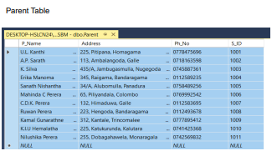
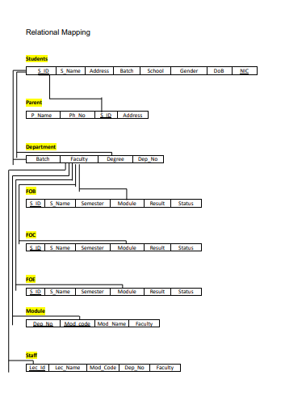
structures
Database design
Data Modeling

Slide 9
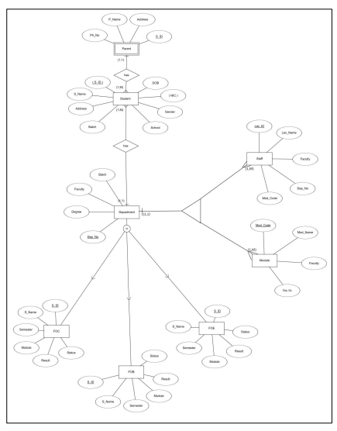
EER Diagram

Slide 10
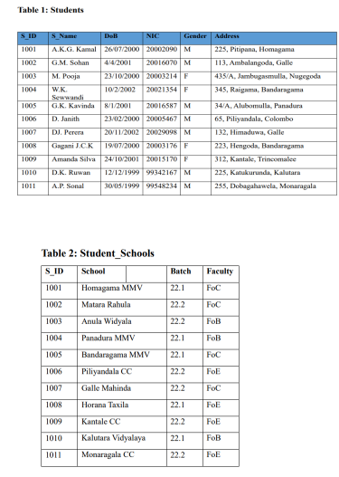
Data Normalization

Slide 11
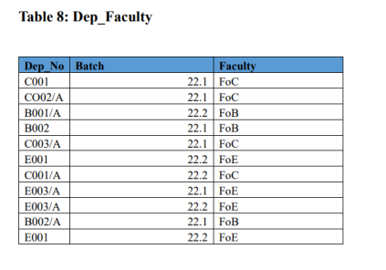

Slide 12
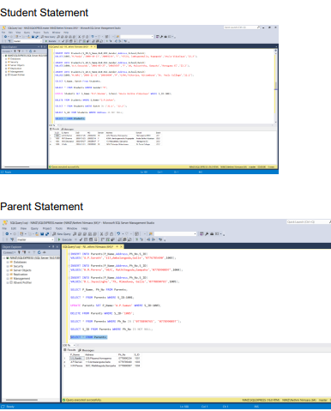
Testing

Slide 13

Results and Analysis
Data Validation and Accuracy
Performance Analysis
User Feedback
Usage Metrics
Impact on Operations
Security Audit
Documentation Review

Slide 14
Challenges Faced
Data Integration from Various Systems
Security and Privacy Concerns
User Training and Adoption
Cross-Departmental Collaboration
Legacy System Migration
Regulatory Compliance Budget Constraints
Customization for Diverse Needs
Change Management

Slide 15
Future Enhancements:
Features of Security
Connectivity with Different Systems
Mobile and Web Interfaces
Messages Sent Out Automatically

Slide 16
Conclusion
Achievements
User Feedback and Satisfaction
Next Steps

Slide 17

Thank you

